Slide 1



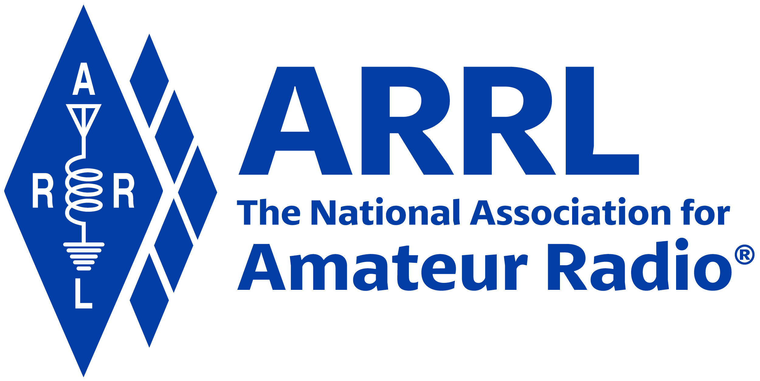
Amateur Radio Technician Exam Preparation Course

Slide 2
Amateur Radio Technician Exam Prep Course
Module 3
Electricity, Components, and Circuits
3.1 Electricity
3.2 Components and Units
3.3 Radio Circuits

Slide 3
Fundamentals of Electricity
Radios are powered by electricity and radio signals are a form of electrical energy
A basic understanding of how we control electricity allows you to better install and operate your radio
Electrical charge can be positive or negative
  Opposite charges attract each other (like charges repel)
Electrical current is the flow of electrons
  Electrons are negatively-charged atomic particles, usually surrounding an atom’s positively-charged nucleus of protons (positive) and neutrons (neutral – no charge)
  Electrons move in response to an electromotive force and can move independently of atoms

Slide 4
Basic Electrical Concepts
Current: the movement of electrons, measured in amperes (A) by an ammeter, and represented by I (capital letter “i”) in formulas
Voltage: the amount of electromotive force (emf), also called electrical potential, measured in volts (V) by a voltmeter, represented by E or V in formulas
Resistance: the opposition to the movement of electrons, measured in ohms (Ω) by an ohmmeter and represented by R (sometimes Ω in scientific publications) in formulas
Resistance is like friction and turns electrical energy into heat when current flows
Conductors permit current flow (low resistance) and insulators block current flow (high resistance)

Slide 5
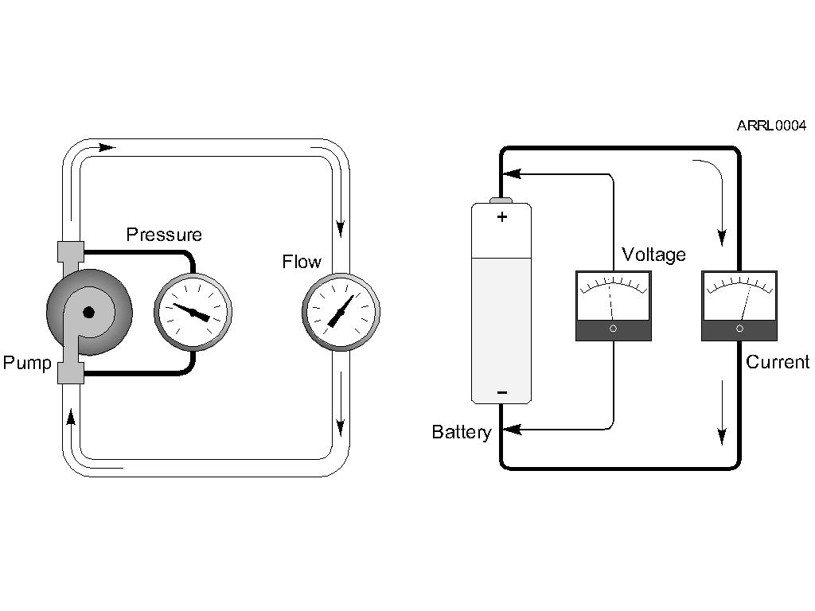
Basic Electrical Concepts (cont.)
The flow of water through a pipe is a good analogy to understand the three characteristics of electricity and how they are related

Slide 6
Basic Electrical Concepts (cont.)
Polarity refers to the convention that determines which voltages are positive and negative
Voltage from a source of electrical energy causes current to flow
Resistance is a material’s opposition to the flow of current
Voltage, current, and resistance affect each other
  For example, higher voltage (bigger push) causes more current (more flow)

Slide 7
PRACTICE QUESTIONS

Slide 8
Electrical current is measured in which of the following units?
Volts
Watts
Ohms
Amperes
T5A01 D 3-1

Slide 9
What is the name for the flow of electrons in an electric circuit?
Voltage
Resistance
Capacitance
Current
T5A03 D 3-1

Slide 10
What is the electrical term for the force that causes electron flow?
Voltage
Ampere-hours
Capacitance
Inductance
T5A05 A 3-1

Slide 11
Which instrument would you use to measure electric potential?
An ammeter
A voltmeter
A wavemeter
An ohmmeter
Potential could be referred to as Voltage…
T7D01 B 3-1

Slide 12
Which instrument is used to measure electric current?
An ohmmeter
An electrometer
A voltmeter
An ammeter
Current is measured by amperes, so… Amperes would be measured with…?
T7D04 D 3-1

Slide 13
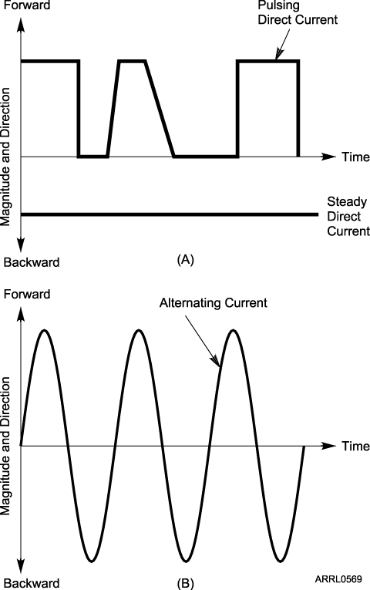
The Two Kinds of Current
Current that flows in only one direction, is called direct current (DC)
  Batteries are a common source of DC
Current that flows in one direction then in the opposite direction is called alternating current (AC)
  Household current is AC
AC current reverses direction on a regular basis
  Each process of reversing is a cycle
  The number of cycles per second is frequency, measured in hertz (Hz)
1 Hz = 1 cycle per second

Slide 14
Current Flow
A circuit is any path through which current can flow
Electrical circuits are made from components and the connections between them
If two or more components are connected in a circuit so that the same current must flow through all of them, that is a series circuit
A short circuit is a direct connection between two points in a circuit
An open circuit is made by breaking a current path in a circuit

Slide 15
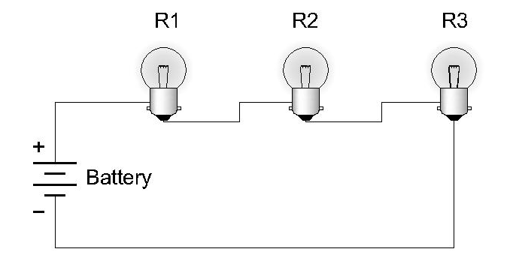
Series Circuit
Same CURRENT at all points in the circuit. Series circuits provide one and only one path for current flow.

Slide 16
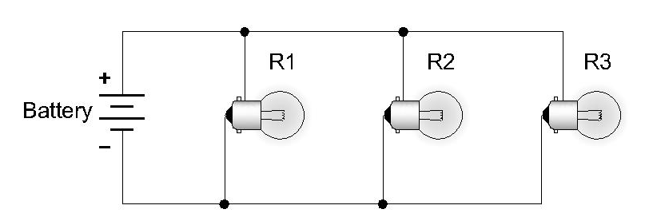
Parallel Circuit
Same VOLTAGE at all parts of the circuit. Parallel circuits provide multiple paths for current flow.

Slide 17
PRACTICE QUESTIONS

Slide 18
Which of the following describes alternating current?
Current that alternates between a positive direction and zero
Current that alternates between a negative direction and zero
Current that alternates between positive and negative directions
All these answers are correct
T5A09 C 3-1

Slide 19
In which type of circuit is DC current the same through all components?
Series
Parallel
Resonant
Branch
T5D13 A 3-2

Slide 20
In which type of circuit is voltage the same across all components?
Series
Parallel
Resonant
Branch
T5D14 B 3-2

Slide 21
How is a voltmeter connected to a component to measure applied voltage?
In series
In parallel
In quadrature
In phase
T7D02 B 3-2

Slide 22
When configured to measure current, how is a multimeter connected to a component?
In series
In parallel
In quadrature
In phase
T7D03 A 3-2

Slide 23
Multimeters
The basic electrical test instruments are simple meters: voltmeters, ammeters, and ohmmeters
So that a separate meter isn’t needed for each parameter, the multimeter was invented
  Short for “multifunction meter”
  Measures all three electrical values of voltage, current, and resistance
  Other names: VOM (volt-ohm meter) or DVM (digital volt meter)
Ways meters are damaged …
  Measuring voltage of an energized circuit when the meter is set to measure resistance
  Exceeding meter’s voltage rating … voltmeter and leads not rated for use at the voltages to be measured

Slide 24
PRACTICE QUESTIONS

Slide 25
Which of the following can damage a multimeter?
Attempting to measure resistance using the voltage setting
Failing to connect one of the probes to ground
Attempting to measure voltage when using the resistance setting
Not allowing it to warm up properly
T7D06 C 3-4

Slide 26
Which of the following measurements are made using a multimeter?
Signal strength and noise
Impedance and reactance
Voltage and resistance
All these choices are correct
T7D07 C 3-4

Slide 27
Which of the following precautions should be taken when measuring in-circuit resistance with an ohmmeter?
Ensure that the applied voltages are correct
Ensure that the circuit is not powered
Ensure that the circuit is grounded
Ensure that the circuit is operating at the correct frequency
T7D11 B 3-4

Slide 28
Which of the following precautions should be taken when measuring high voltages with a voltmeter?
Ensure that the voltmeter has very low impedance
Ensure that the voltmeter and leads are rated for use at the voltages to be measured
Ensure that the circuit is grounded through the voltmeter
Ensure that the voltmeter is set to the correct frequency
T0A12 B 3-4

Slide 29
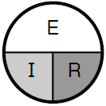
Ohm’s Law
E represents voltage
  Units – volts (V)
I represents current
  Units – amperes (A)
R represents resistance
  Units – ohms (Ω)
Figure 3.5A — Simple diagram to help remember the Ohm’s Law. If you know any two of the quantities, the equation to find the third — just cover up the unknown quantity. The positions of the remaining two symbols show if you have to multiply (side-by-side) or divide (one above the other).
R = E / I
I = E / R
E = I x R
Notes:
You can ask for a blank sheet of paper

Slide 30
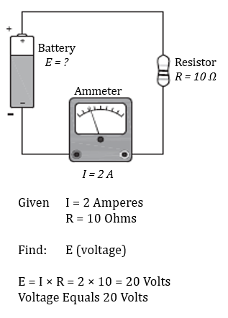
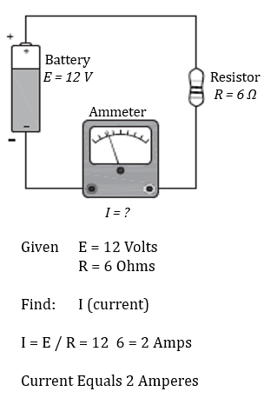
Examples of how to use Ohm’s Law

Slide 31
More Ohm’s Law Examples
What is the resistance of a circuit in which a current of 3 amperes flows when connected to 90 volts?
R = E / I = 90 V / 3 A = 30 Ω
What is the current in a circuit with an applied voltage of 120 volts and a resistance of 80 ohms?
I = E / R = 120 V / 80 Ω = 1.5 A
What is the voltage across a 2-ohm resistor if a current of 0.5 amperes flows through it?
E = I × R = 0.5 A × 2 Ω = 1 V

Slide 32
PRACTICE QUESTIONS

Slide 33
What are the units of electrical resistance?
Siemens
Mhos
Ohms
Coulombs
T5A04 C 3-5

Slide 34
Why are metals generally good conductors of electricity?
They have relatively high density
They have many free electrons
They have many free protons
All these choices are correct
T5A07 B 3-5
Notes:
Remember, electricity is moving electrons.

Slide 35
Which of the following is a good electrical insulator?
Copper
Glass
Aluminum
Mercury
T5A08 B 3-5

Slide 36
What formula is used to calculate current in a circuit?
I = E × R
I = E / R
I = E + R
I = E – R
T5D01 B 3-5

Slide 37
What formula is used to calculate voltage in a circuit?
E = I x R
E = I / R
E = I + R
E = I – R
T5D02 A 3-5

Slide 38
What formula is used to calculate resistance in a circuit?
R = E x I
R = E / I
R = E + I
R = E – I
T5D03 B 3-5

Slide 39
What is the resistance of a circuit in which a current of 3 amperes flows when connected to 90 volts?
3 ohms
30 ohms
93 ohms
270 ohms
90V=E
3A=I
R=?
R=E/I
R=90V/3A
R=30Ω
T5D04 B 3-6

Slide 40
What is the resistance of a circuit for which the applied voltage is 12 volts and the current flow is 1.5 amperes?
18 ohms
0.125 ohms
8 ohms
13.5 ohms
T5D05 C 3-6

Slide 41
What is the resistance of a circuit that draws 4 amperes from a 12-volt source?
3 ohms
16 ohms
48 ohms
8 ohms
T5D06 A 3-6

Slide 42
What is the current in a circuit with an applied voltage of 120 volts and a resistance of 80 ohms?
9600 amperes
200 amperes
0.667 amperes
1.5 amperes
T5D07 D 3-6

Slide 43
What is the current through a 100-ohm resistor connected across 200 volts?
20,000 amperes
0.5 amperes
2 amperes
100 amperes
T5D08 C 3-6

Slide 44
What is the current through a 24-ohm resistor connected across 240 volts?
24,000 amperes
0.1 amperes
10 amperes
216 amperes
T5D09 C 3-6

Slide 45
What is the voltage across a 2-ohm resistor if a current of 0.5 amperes flows through it?
1 volt
0.25 volts
2.5 volts
1.5 volts
T5D10 A 3-6

Slide 46
What is the voltage across a 10-ohm resistor if a current of 1 ampere flows through it?
1 volt
10 volts
11 volts
9 volts
T5D11 B 3-7

Slide 47
What is the voltage across a 10-ohm resistor if a current of 2 amperes flows through it?
8 volts
0.2 volts
12 volts
20 volts
T5D12 D 3-7

Slide 48
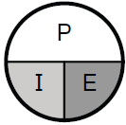
Power
Power, represented by the symbol P, is the rate at which electrical energy is used
  Measured in watts (W)
A device that consumes or dissipates power is referred to as a load
Figure 3.5B — Simple diagram to help remember the Ohm’s Law. If you know any two of the quantities, the equation to find the third — just cover up the unknown quantity. The positions of the remaining two symbols show if you have to multiply (side-by-side) or divide (one above the other).
P = I × E
E = P / I
I = P / E

Slide 49
Example Power Calculations
How much power is delivered by a voltage of 13.8 volts DC and a current of 10 amperes?
P = E × I = 13.8 V × 10 A = 138 W
How much current is required to deliver 120 watts at a voltage of 12 volts DC?
I = P / E = 120 W / 12 V = 10 A

Slide 50
PRACTICE QUESTIONS

Slide 51
Electrical power is measured in which of the following units?
Volts
Watts
Watt-hours
Amperes
T5A02 B 3-7

Slide 52
Which term describes the rate at which electrical energy is used?
Resistance
Current
Power
Voltage
T5A10 C 3-7

Slide 53
What is the formula used to calculate electrical power (P) in a DC circuit?
P = I × E
P = E / I
P = E – I
P = I + E
T5C08 A 3-7

Slide 54
How much power is delivered by a voltage of 13.8 volts DC and a current of 10 amperes?
138 watts
0.7 watts
23.8 watts
3.8 watts
T5C09 A 3-7

Slide 55
How much power is delivered by a voltage of 12 volts DC and a current of 2.5 amperes?
4.8 watts
30 watts
14.5 watts
0.208 watts
T5C10 B 3-7

Slide 56
How much current is required to deliver 120 watts at a voltage of 12 volts DC?
0.1 amperes
10 amperes
12 amperes
132 amperes
T5C11 B 3-7

Slide 57
BREAK TIME!

Slide 58
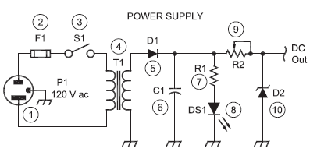
Components and Units
Components in electrical circuits performs functions such as storing or using energy, routing current, or amplifying signals
The three most basic types of electronic components are resistors, capacitors and inductors
We could use actual drawings to show how components are arranged in circuits, but this would be too cumbersome for most circuitry. Instead, we use schematic diagrams …
More on schematics later …

Slide 59
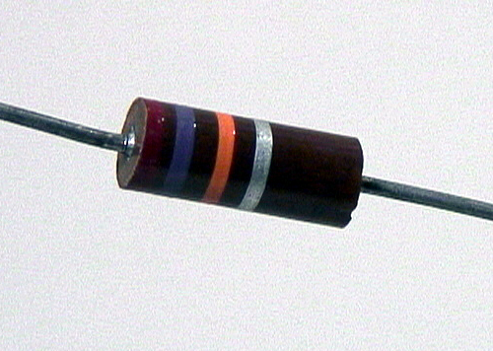

Resistors
Function: To restrict the flow of current, just as a valve in a water pipe restricts the flow through the pipe
Resistance measured in ohms (Ω)
Remember Ohm’s Law
Schematic
Picture
Potentiometer
or “Pot”
Arrow indicates adjustable value, such as for a volume control.
Resistor Schematic

Slide 60
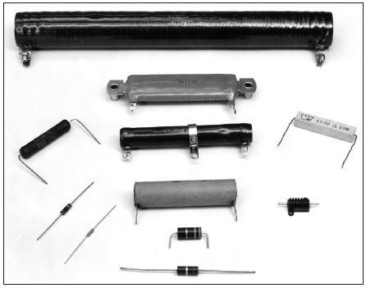
Large Variety of Resistors!

Slide 61
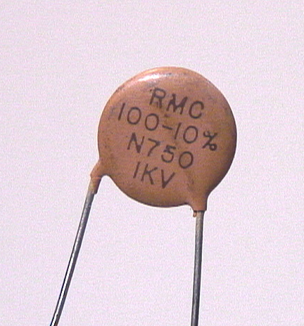
Capacitors
The function of a capacitor is to store electrical energy – called capacitance
Schematic symbol
Acts like a battery
Picture
Electrodes
Schematic
Stores energy in an electric field created by voltage between the electrodes with insulating dielectric material between them

Slide 62
Capacitors (cont.)
Store electrical energy in the electric field created by a voltage between two conducting surfaces or electrodes
Electrodes are separated by an insulator or dielectric
Storing energy this way is called capacitance, and it is measured in farads (F)

Slide 63
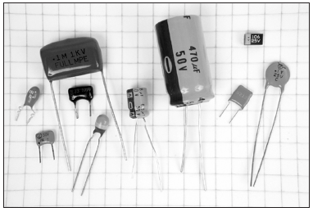
Large Variety of Capacitors!

Slide 64
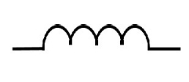
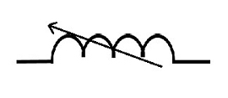
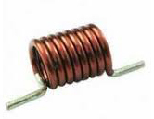
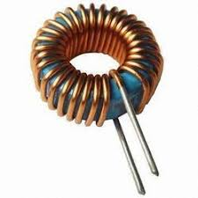
Inductors
Function: To store energy in the magnetic field created by current flowing in a wire
Called inductance, measured in henrys (H)
Made from wire wound in a coil, sometimes around a core of magnetic material that concentrates the magnetic energy
Schematic
Picture
Schematic

Slide 65
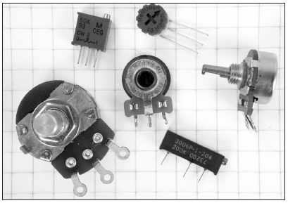
Variable Components
All three types of basic components are also available as adjustable or variable models
A variable resistor is also called a potentiometer, frequently used to adjust voltage or potential, such as for a volume control

Slide 66
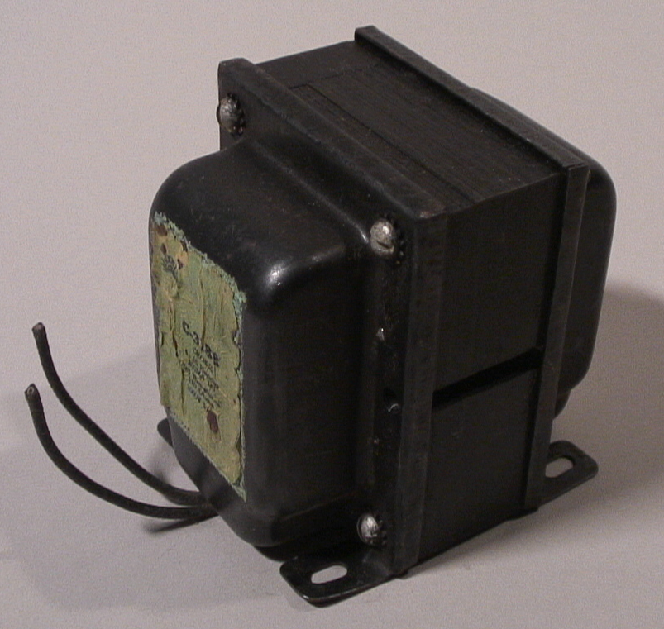
Transformers
Made from two or more inductors that share their stored energy
Allows energy to be transferred from one inductor to another while changing the combination of voltage and current
Example: A transformer is used to transfer energy from household 120 V AC voltage to a lower voltage for other uses such as in electronic equipment

Slide 67
PRACTICE QUESTIONS

Slide 68
What describes the ability to store energy in an electric field?
Inductance
Resistance
Tolerance
Capacitance
T5C01 D 3-8

Slide 69
What reading indicates that an ohmmeter is connected across a large, discharged capacitor?
Increasing resistance with time
Decreasing resistance with time
Steady full-scale reading
Alternating between open and short circuit
T7D10 A 3-4

Slide 70
What is the unit of capacitance?
The farad
The ohm
The volt
The henry
T5C02 A 3-8

Slide 71
What describes the ability to store energy in a magnetic field?
Admittance
Capacitance
Resistance
Inductance
T5C03 D 3-8

Slide 72
What is the unit of inductance?
The coulomb
The farad
The henry
The ohm
T5C04 C 3-8

Slide 73
What electrical component opposes the flow of current in a DC circuit?
Inductor
Resistor
Inverter
Transformer
T6A01 B 3-8

Slide 74
What type of component is often used as an adjustable volume control?
Fixed resistor
Power resistor
Potentiometer
Transformer
T6A02 C 3-8

Slide 75
What electrical parameter is controlled by a potentiometer?
Inductance
Resistance
Capacitance
Field strength
T6A03 B 3-8

Slide 76
What electrical component stores energy in an electric field?
Varistor
Capacitor
Inductor
Diode
T6A04 B 3-8

Slide 77
What type of electrical component consists of conductive surfaces separated by an insulator?
Resistor
Potentiometer
Oscillator
Capacitor
T6A05 D 3-8

Slide 78
What type of electrical component stores energy in a magnetic field?
Varistor
Capacitor
Inductor
Diode
T6A06 C 3-8

Slide 79
What electrical component is typically constructed as a coil of wire?
Switch
Capacitor
Diode
Inductor
T6A07 D 3-8

Slide 80
What component changes 120 V AC power to a lower AC voltage for other uses?
Variable capacitor
Transformer
Transistor
Diode
T6D06 B 3-8

Slide 81
Reactance and Impedance
In a resistor, AC voltages and currents are exactly in step, or in phase
In capacitors and inductors, voltage and current have a phase difference
Capacitors and inductors store energy, rather than dissipating it like resistors
Energy storage creates an effect called reactance (symbol X) that acts like a resistance in opposing the flow of AC current
  Capacitors create capacitive reactance (X_{C})
  Inductors create inductive reactance (X_{L})
  The effects of each are complementary

Slide 82
Reactance and Impedance (cont.)
The combination of resistance (R) and reactance (X) is called impedance, represented by the symbol Z
Impedance represents a circuit’s opposition to both AC and DC currents
Radio circuits almost always have both resistance and reactance, so impedance is often used as a general term to mean the circuit’s opposition to AC current flow

Slide 83
PRACTICE QUESTIONS

Slide 84
What is the unit of impedance?
The volt
The ampere
The coulomb
The ohm
T5C05 D 3-10

Slide 85
What is impedance?
The opposition to AC current flow
The inverse of resistance
The Q or Quality Factor of a component
The power handling capability of a component
T5C12 A 3-10

Slide 86
Resonance
Circuits that contain both a capacitor and an inductor are called resonant circuits or tuned circuits
A component’s reactance depends on frequency
  X_{L} increases with frequency while X_{C} decreases
At the frequency for which a circuit’s X_{L} and X_{C} are equal, their effects cancel
  This is the circuit’s resonant frequency
At resonance, a circuit has only resistance, which affects AC and DC current equally
A tuned circuit acts as a filter, passing or rejecting signals at its resonant frequency

Slide 87
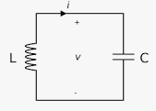
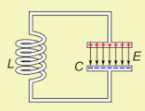
Resonant or Tuned Circuit
Capacitors and inductors connected together create a tuned circuit
When X_{L} and X_{C} are equal, the circuit is resonant
If C or L are adjustable, the resonant frequency can be varied or tuned

Slide 88
PRACTICE QUESTIONS

Slide 89
Which of the following is combined with an inductor to make a resonant circuit?
Resistor
Zener diode
Potentiometer
Capacitor
T6D08 D 3-10

Slide 90
Which of the following is a resonant or tuned circuit?
An inductor and a capacitor in series or parallel
A linear voltage regulator
A resistor circuit used for reducing standing wave ratio
A circuit designed to provide high-fidelity audio
T6D11 A 3-10

Slide 91
Diodes, Transistors and Integrated Circuits
(Semiconductors)
Made of material like silicon that are “OK” conductors but not as good as metals
Impurities added to semiconductors create material with more than usual electrons (N-type) and fewer than usual electrons (P-type)
Structures of N and P material can control current flow through the semiconductor
When N- and P-type material are placed in contact with each other, the result is a PN junction that conducts better in one direction than the other

Slide 92
Diodes
Allows current to flow in only one direction
  Two electrodes (Anode, Cathode)
  AC current is changed to varying pulses of DC (called rectification)
  Diodes used to change AC power to DC power are called rectifiers (heavy-duty diodes)
Schematic
Designator (D or CR)
If AC voltage is applied to a diode, the result is a pulsing DC current because current is blocked when the voltage tries to push electrons in the wrong direction
Anode
Cathode
Arrows
indicate light (LED)
Stripe on diode indicates CATHODE
Notes:
Top is a Junction Diode, Second is a Zener Diode, third is a Schottky Diode, last is an LED (Light Emitting Diode)

Slide 93
Diodes (cont.)
When current flows through a diode, a small positive voltage develops from the anode to the cathode
  Called forward voltage drop, usually less than 1 V
  Voltage depends on the type of diode and the materials it’s made from
Light-emitting diode or LED gives off light when current flows through it in the forward direction from anode to cathode
  Used as visual indicators (use less power than incandescent bulbs/lamps)
  Material from which the LED is made determines the color of light emitted

Slide 94
Transistors
The function of a transistor is to control large signals with small ones
  An “electronically controlled current valve”
  When used as an amplifier, a transistor produces gain
  Transistors can also be used as a switch
Schematic
Designator (Q)
Bipolar Junction Transistor (BJT)
Field-Effect Transistor (FET)

Slide 95
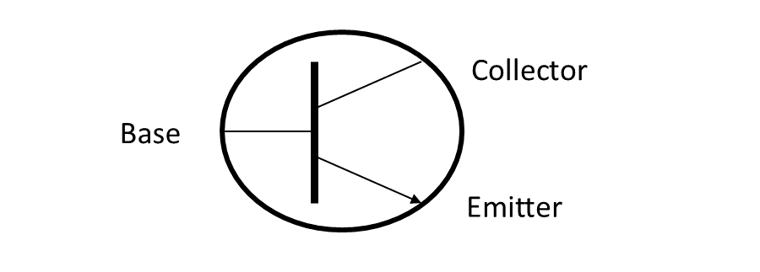
Transistors (cont.)
Two common types of transistors: bipolar junction transistors (BJT) and field effect transistors (FET)
The Bipolar Junction Transistor (BJT) has three layers of N or P material connected to electrodes
Depending on the arrangement of layers, a BJT is either an NPN or PNP transistor
The three electrodes of an FET are the gate, drain, and source
RF power transistors are used as the primary gain-producing component in RF power amplifiers
Bipolar Junction Transistor Schematic
(showing the 3 electrodes)

Slide 96
Transistors (cont.)
The Field-Effect Transistor (FET) has a conducting path or channel of N and P material connected to the drain and source electrodes
Voltage applied to the gate electrode controls current through the channel
Drain
Gate
Source

Slide 97
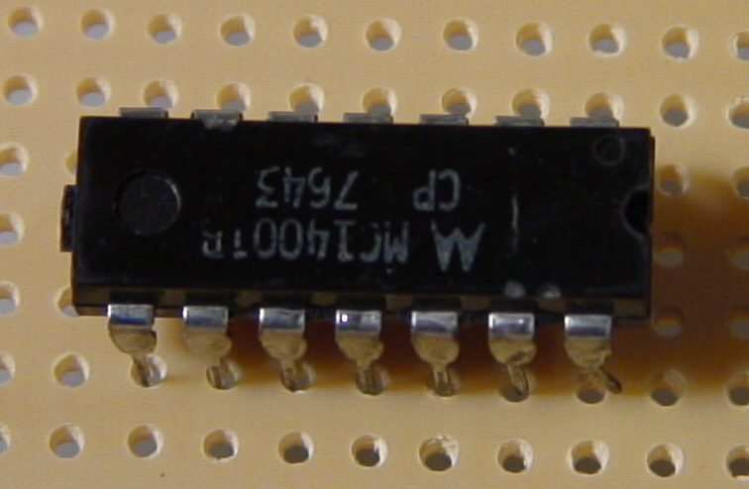
Integrated Circuits
An integrated circuit (IC or chip) is made of many components connected together as a useful circuit and packaged as a single component
Schematic symbol
Designator (IC or U)
D
Q
CLK
Q
_
+

Slide 98
PRACTICE QUESTIONS

Slide 99
Which is true about forward voltage drop in a diode?
It is lower in some diode types than in others
It is proportional to peak inverse voltage
It indicates that the diode is defective
It has no impact on the voltage delivered to the load
T6B01 A 3-10

Slide 100
What electronic component allows current to flow in only one direction?
Resistor
Fuse
Diode
Driven element
T6B02 C 3-10

Slide 101
Which of these components can be used as an electronic switch?
Varistor
Potentiometer
Transistor
Thermistor
T6B03 C 3-10

Slide 102
Which of the following components can consist of three regions of semiconductor material?
Alternator
Transistor
Triode
Pentagrid converter
T6B04 B 3-10

Slide 103
What type of transistor has a gate, drain, and source?
Varistor
Field-effect
Tesla-effect
Bipolar junction
Drain
Gate
Source
T6B05 B 3-10

Slide 104
How is the cathode lead of a semiconductor diode often marked on the package?
With the word “cathode”
With a stripe
With the letter C
With the letter K
T6B06 B 3-10

Slide 105
What causes a light-emitting diode (LED) to emit light?
Forward current
Reverse current
Capacitively-coupled RF signal
Inductively-coupled RF signal
T6B07 A 3-10

Slide 106
What does the abbreviation FET stand for?
Frequency Emission Transmitter
Fast Electron Transistor
Free Electron Transmitter
Field Effect Transistor
T6B08 D 3-10

Slide 107
What are the names for the electrodes of a diode?
Plus and minus
Source and drain
Anode and cathode
Gate and base
T6B09 C 3-10

Slide 108
Which of the following can provide power gain?
Transformer
Transistor
Reactor
Resistor
T6B10 B 3-11

Slide 109
What is the term that describes a device’s ability to amplify a signal?
Gain
Forward resistance
Forward voltage drop
On resistance
T6B11 A 3-11

Slide 110
What are the names of the electrodes of a bipolar junction transistor?
Signal, bias, power
Emitter, base, collector
Input, output, supply
Pole one, pole two, output
Bipolar Junction Transistor Schematic
(showing the 3 electrodes)
T6B12 B 3-11

Slide 111
Which of the following devices or circuits changes an alternating current into a varying direct current signal?
Transformer
Rectifier
Amplifier
Reflector
T6D01 B 3-11

Slide 112
Which of the following is commonly used as a visual indicator?
LED
FET
Zener diode
Bipolar transistor
T6D07 A 3-11

Slide 113
What is the name of a device that combines several semiconductors and other components into one package?
Transducer
Multi-pole relay
Integrated circuit
Transformer
T6D09 C 3-11

Slide 114
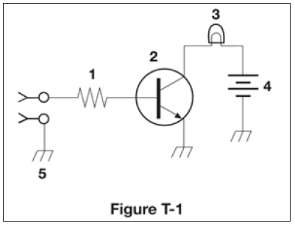
What is the function of component 2 in figure T-1?
Give off light when current flows through it
Supply electrical energy
Control the flow of current
Convert electrical energy into radio waves
T6D10 C 3-11

Slide 115
Protective Components
Protective components (such as fuses and circuit breakers) are used to prevent equipment damage or safety hazards such as fire or electrical shock
Designed to remove power in case of a circuit overload
  Fuses blow – one time protection
  Circuit breakers trip – can be reset and reused
Fuses interrupt current overloads by melting a short length of metal – when the metal melts, the current path is broken and power is removed from circuits
Replacing a fuse or circuit breaker with one with a higher current rating could allow the fault to permanently damage the equipment or start a fire

Slide 116
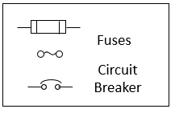
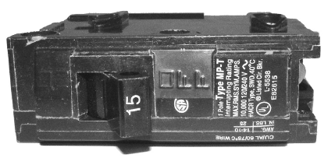
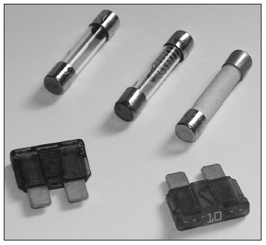
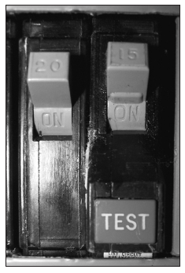
Schematics
Circuit Breaker
Ground Fault Circuit Interrupter (GFCI) circuit breaker
Fuses

Slide 117
PRACTICE QUESTIONS

Slide 118
What electrical component is used to protect other circuit components from current overloads?
Fuse
Thyratron
Varactor
All these choices are correct
T6A09 A 3-12

Slide 119
What is the purpose of a fuse in an electrical circuit?
To prevent power supply ripple from damaging a component
To remove power in case of overload
To limit current to prevent shocks
All these choices are correct
T0A04 B 3-12

Slide 120
Why should a 5-ampere fuse never be replaced with a 20-ampere fuse?
The larger fuse would be likely to blow because it is rated for higher current
The power supply ripple would greatly increase
Excessive current could cause a fire
All these choices are correct
T0A05 C 3-12

Slide 121
Circuit Gatekeepers … Switches & Relays
Switches and relays control current through a circuit by connecting and disconnecting paths for current to follow
Switches and relays are described by their number of poles and the number of throws
  The combination of poles and throws describes the switch
  Each circuit controlled by the switch is a pole
  Each position is called a throw
A switch is operated manually while a relay is a switch controlled by an electromagnet

Slide 122
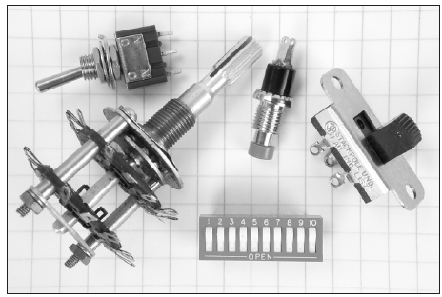
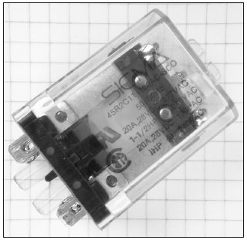
Switch Configurations
SPST
Switches
SPDT
DPDT
Pushbutton
Relay

Slide 123
Indicator, Meters and Displays
Indicators and displays are important components for radio equipment
  An indicator is either ON or OFF
A meter provides information as a value in the form of numbers or on a numeric scale
A display combines indicators, numbers, and labels
  A liquid crystal display or LCD is used on the front panel of many radios and test instruments

Slide 124
PRACTICE QUESTIONS

Slide 125
What is the function of an SPDT switch?
A single circuit is opened or closed
Two circuits are opened or closed
A single circuit is switched between one of two other circuits
Two circuits are each switched between one of two other circuits
T6A08 C 3-13

Slide 126
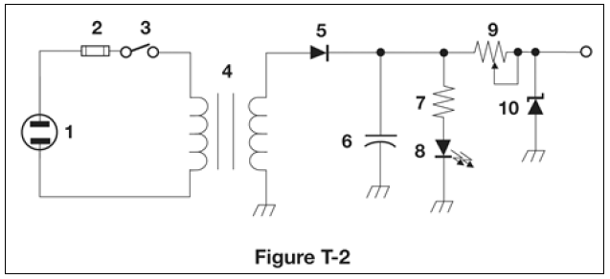
What type of switch is represented by component 3 in figure T-2?
Single-pole single-throw
Single-pole double-throw
Double-pole single-throw
Double-pole double-throw
T6A12 A 3-13

Slide 127
What is a relay?
An electrically-controlled switch
A current controlled amplifier
An inverting amplifier
A pass transistor
T6D02 A 3-13

Slide 128
Which of the following displays an electrical quantity as a numeric value?
Potentiometer
Transistor
Meter
Relay
T6D04 C 3-14

Slide 129
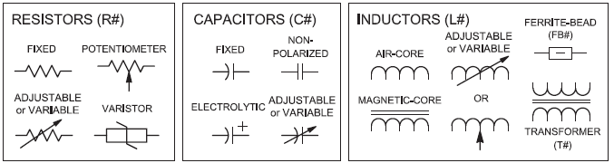
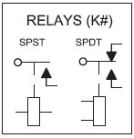
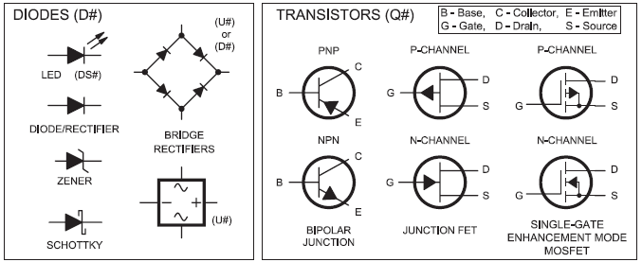
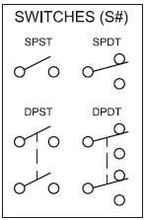
Fig 3.15 – Schematic Symbols (see text)

Slide 130
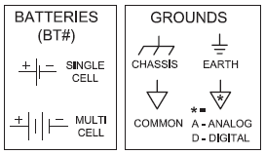
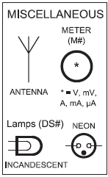
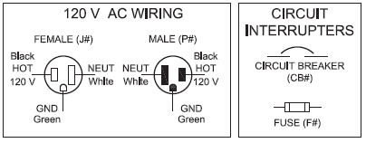
Fig 3.15 – Schematic Symbols (cont., see text)

Slide 131
Schematic Diagrams and Symbols
Symbols are used when drawing a circuit because there are so many types of components
Schematic diagrams are a visual description of a circuit and its components that uses standardized drawings called circuit symbols
  Shows how the components are connected electrically

Slide 132
PRACTICE QUESTIONS

Slide 133
What is the name of an electrical wiring diagram that uses standard component symbols?
Bill of materials
Connector pinout
Schematic
Flow chart
T6C01 C 3-14

Slide 134

What is component 1 in figure T-1?
Resistor
Transistor
Battery
Connector
T6C02 A 3-14

Slide 135
What is component 2 in figure T-1?
Resistor
Transistor
Indicator lamp
Connector
T6C03 B 3-14

Slide 136
What is component 3 in figure T-1?
Resistor
Transistor
Lamp
Ground symbol
T6C04 C 3-14

Slide 137
What is component 4 in figure T-1?
Resistor
Transistor
Ground symbol
Battery
T6C05 D 3-14

Slide 138
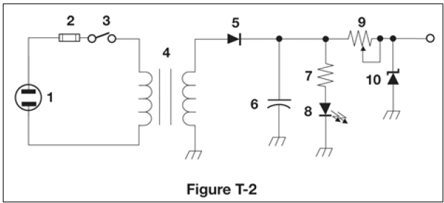
What is component 6 in figure T-2?
Resistor
Capacitor
Regulator IC
Transistor
T6C06 B 3-14

Slide 139
What is component 8 in figure T-2?
Resistor
Inductor
Regulator IC
Light emitting diode
T6C07 D 3-14

Slide 140
What is component 9 in figure T-2?
Variable capacitor
Variable inductor
Variable resistor
Variable transformer
T6C08 C 3-14

Slide 141
What is component 4 in figure T-2?
Variable inductor
Double-pole switch
Potentiometer
Transformer
T6C09 D 3-14

Slide 142
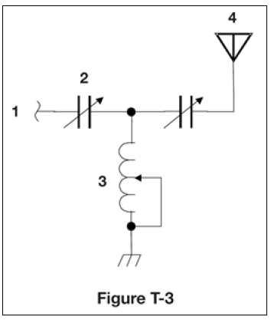
What is component 3 in figure T-3?
Connector
Meter
Variable capacitor
Variable inductor
T6C10 D 3-14

Slide 143
What is component 4 in figure T-3?
Antenna
Transmitter
Dummy load
Ground
T6C11 A 3-14

Slide 144
Which of the following is accurately represented in electrical schematics?
Wire lengths
Physical appearance of components
Component connections
All these choices are correct
T6C12 C 3-14

Slide 145
Radio Circuits
An oscillator produces a steady signal at one frequency
  Used in both receivers and transmitters to determine the operating frequency
The process of combining data or voice signals with an RF signal is modulation
Modulators add the data or voice signal to an RF signal or carrier
  A demodulator circuit extracts the information from a modulated signal
Mixers combine two RF signals and shift one of them to a third frequency (closely related to a modulator)

Slide 146
PRACTICE QUESTIONS

Slide 147
What is the name of a circuit that generates a signal at a specific frequency?
Reactance modulator
Phase modulator
Low-pass filter
Oscillator
T7A05 D 3-17

Slide 148
Which of the following describes combining speech with an RF carrier signal?
Impedance matching
Oscillation
Modulation
Low-pass filtering
T7A08 C 3-17

Slide 149
Which of the following is used to convert a signal from one frequency to another?
Phase splitter
Mixer
Inverter
Amplifier
T7A03 B 3-18

Slide 150

END OF MODULE 3

